Slide 1
“MEASURING DIMENSION OF IRRUGULAR OBJECTS
USING MATLAB ”
By
Mini-Project Phase-01
PRESENTATION
ON
ANAND 1NH17EC005
Guided By
Dr Dhivya
Assistant Professor
Dept. of ECE
New Horizon College Of Engineering

Slide 2
INDEX
Introduction
Literature Survey
Aim and Objectives of Project
Top Level Block Diagram
Project Description
Progress Work
Milestones/Schedule
      Outcome of Project
      References

Slide 3
INTRODUCTION
Measuring dimensions of irregular object allows us to measure distances, length and width using a wide variety of digital images, including those taken with a digital camera also.
It has to be isolated by the color of the object we want to measure from the surrounding objects, standard color composite of digital imagery in which the color intensities of red, green, and blue are the color characteristics across the entire image

Slide 4
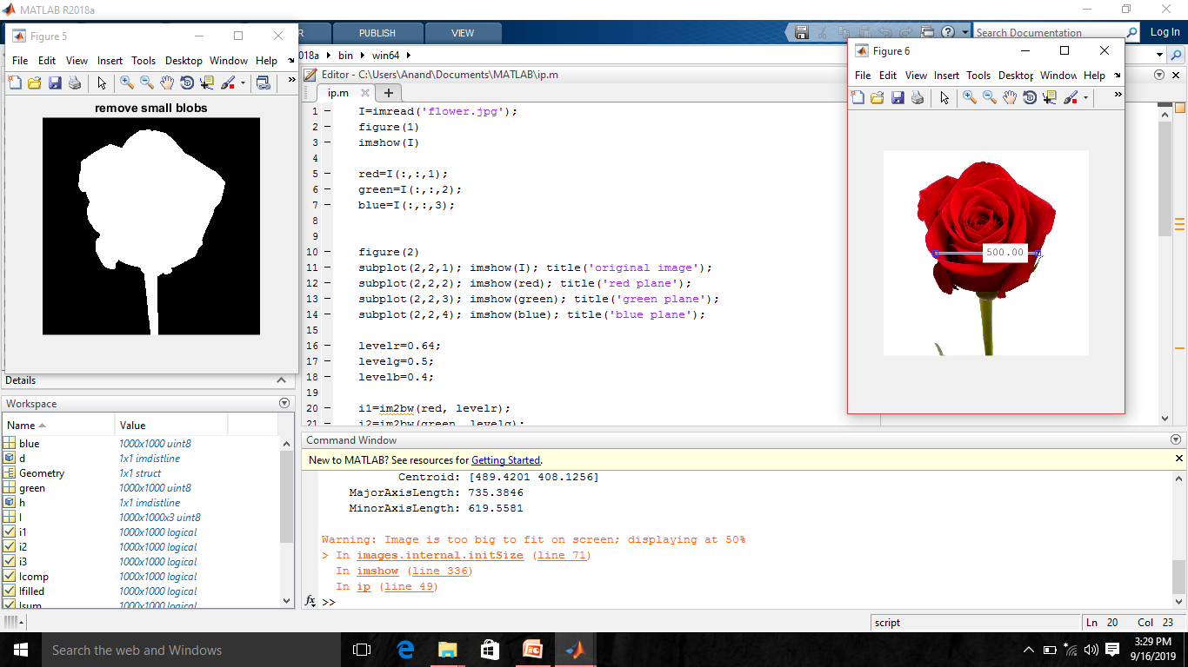
Place a General Picture about the Project

Slide 5
LITERATURE REVIEW
Paper No | Title | Author & Year of Publication | Outcome
1. | Image Processing Made Easy. | Perf. Andy Thé. Mathworks. N.p., 15 Oct. 2014. Web. 07 Nov. 2014. | Image Segmentation
2. | Digital Image Processing | Rafael C Gonza,lez, 2009 | Image Thresholds and intensities
3. | Matlab and Introduction with Application | Amos Gilit, 2003 | Region properties

Slide 6
AIM and OBJECTIVE
AIM: To Image processing for identifying dimension
Objective:
1. Visualizing images and intermediate results
2. Processing large images with limited memory
3. Executing algorithms faster

Slide 7
MATLAB CODE
I=imread('flower.jpg');
figure(1)
imshow(I)
red=I(:,:,1);
green=I(:,:,2);
blue=I(:,:,3);
figure(2)
subplot(2,2,1); imshow(I); title('original image');
subplot(2,2,2); imshow(red); title('red plane');
subplot(2,2,3); imshow(green); title('green plane');
subplot(2,2,4); imshow(blue); title('blue plane');

Slide 8
MATLAB CODE
levelr=0.64;
levelg=0.5;
levelb=0.4;
i1=im2bw(red, levelr);
i2=im2bw(green, levelg);
i3=im2bw(blue, levelb);
Isum=(i1&i2&i3);
figure(3)
subplot(2,2,1); imshow(i1); title('red plane');
subplot(2,2,2); imshow(i2); title('green plane');
subplot(2,2,3); imshow(i3); title('blue plane');
subplot(2,2,4); imshow(Isum); title('Sum of all the planes');

Slide 9
MATLAB CODE
Icomp=imcomplement(Isum);
Ifilled=imfill(Icomp, 'holes');
figure(4)
imshow(Ifilled)
% clear=imclearborder(Ifilled);
% figure(5)
% imshow(clear); title('remove blobs on border');
se=strel('disk' , 15);
open=imopen(Ifilled,se);
figure(5); imshow(open); title('remove small blobs');

Slide 10
MATLAB CODE
Geometry=regionprops(open, 'Majoraxislength', 'Centroid', 'Area','Minoraxislength')
% volume=regionprops3(open,'volume')
figure(6)
imshow(I)
d=imdistline;
h=imdistline;

Slide 11
PROJECT DESCRIPTION
To provide common strategies for image processing
Image display and exploration
Image analysis
Image registration
Geometric transformation

Slide 12
PROGRESS WORK
Image processing techniques has been analysed based on various parameters
Matlab code has been written and testing in progress
Further image processing and enhancements in progress

Slide 13
Milestones/Schedule
Table A - Milestones scheduled for achievement and performance against those milestones:
Milestone | Baseline Date | Target Date | Achievement
Analysing Digital Image Processing Techniques | 30\8\19 | 1\9\19 | 2\9\19
Writing a matlab code and testing | 6\9\19 | 9’9’19 | 11\9\19
Image enhancing | 11\9\19 | 21\9\19

Slide 14
Project Work Distribution
Name of Team Member | Work distributed
Anand Gagan | Matlab techniques for writing code & development of code Development of code and implementation
Karan | Matlab code and Image Enhancement Techniques
Hemanth | Matlab code & presentation, collecting information resources

Slide 15
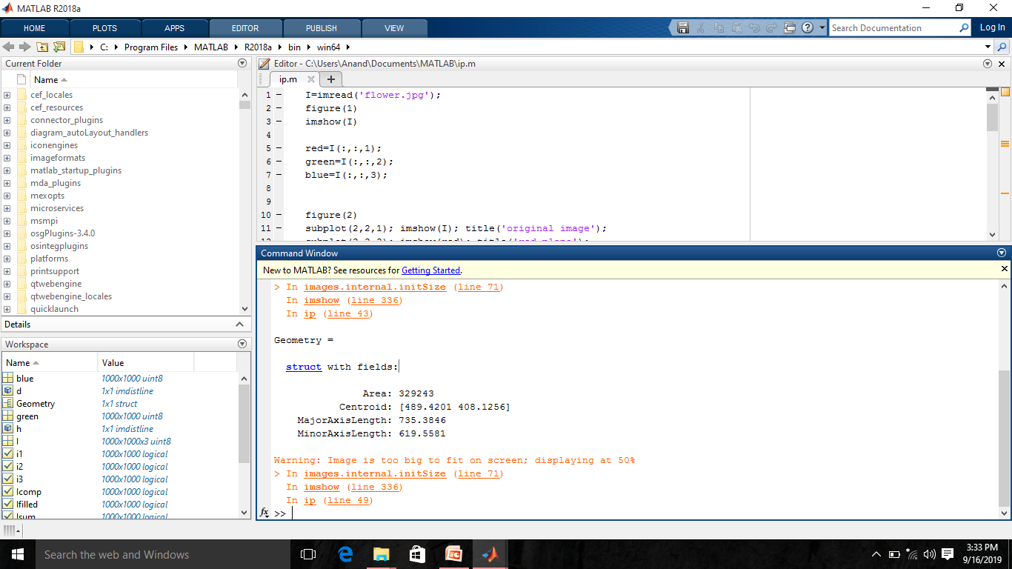
OUTCOME OF PROJECT

Slide 16
REFERENCES
http://www.mathworks.com/videos/image-processing-made-easy-81718.html.

Slide 17


